Slide 1
Project Presentation
Machine Learning Model to predict House Prices using several Regression techniques.
by – Neeraj Pahadiya

Slide 2
About Project
With several explanatory variables describing (almost) every aspect of residential houses, we’ve to predict the final price of each house.

Slide 3

Approach
Data Preprocessing
Feature Engineering
Model Training
Result

Slide 4
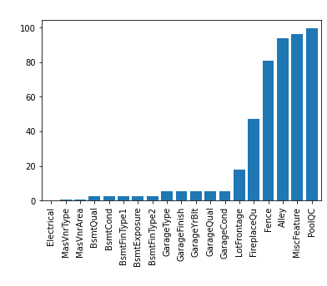
Data Pre-processing
a) To fill in the missing values:
In total 19 features having missing values, we operate in only those features having less than 80% missing values.
To fill continuous missing values, we use mean and in some, we fill in the median based on highly correlated features with it.
To fill categorical missing values, we use most frequent approach and in some, we use ‘None’ by observing them thoroughly.

Slide 5
Data Pre-processing
b) Encoding categorical variables:
We use Ordinal Encoding for the ordinal categorical features .
For nominal features, we use Label Encoding.
We also use One-Hot Encoding.

Slide 6
Feature Engineering
We remove the features having missing values greater than 80% like “Fence”, “PoolQC” etc.
We also remove one of the two features having correlation greater than 0.8, by comparing their priorities in correlation with sales price( target variable ).
Features like “I’d” which is of no use in prediction should also be removed.
After performing all these, we apply feature scaling.

Slide 7
Model Training
As it is a regression problem since the output variable is of continuous type. So, the algorithms which we decided to work on are as follows:
Linear Regression
Random Forest Regressor
XGBoost Regressor

Slide 8
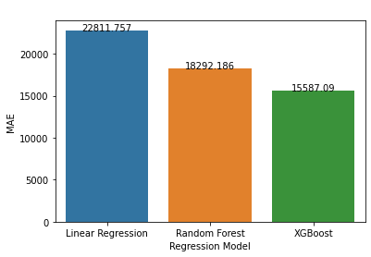
Result
As the XGBoost model exhibit the lowest MAE(mean absolute error), we conclude that it is the best model for this dataset.

Slide 9
References
https://scikit-learn.org/stable/
https://stackoverflow.com/
https://www.kaggle.com/c/home-data-for-ml-course/discussion/143364
https://towardsdatascience.com/smarter-ways-to-encode-categorical-data-for-machine-learning-part-1-of-3-6dca2f71b159

Slide 10
Thank you

